Slide 1
Mining of data stream

Slide 2
Examples of Stream Sources
1 Sensor Data
To learn something about ocean behavior, we might want to deploy a million sensors, each sending back a stream, at the rate of ten per second.
2 Image Data
Satellites often send down to earth streams consisting of many terabytes of images per day.
.

Slide 3
Examples of Stream Sources
3 Internet and Web Traffic
A switching node in the middle of the Internet receives streams of IP packets from many inputs and routes them to its outputs.
Google receives several hundred million search queries per day. Yahoo! accepts billions of “clicks” per day on its various sites. Many interesting things can be learned from these streams. For example, an increase in queries like “sore throat” enables us to track the spread of viruses. A sudden increase in the click rate for a link could indicate some news connected to that page, or it could mean that the link is broken and needs to be repaired

Slide 4
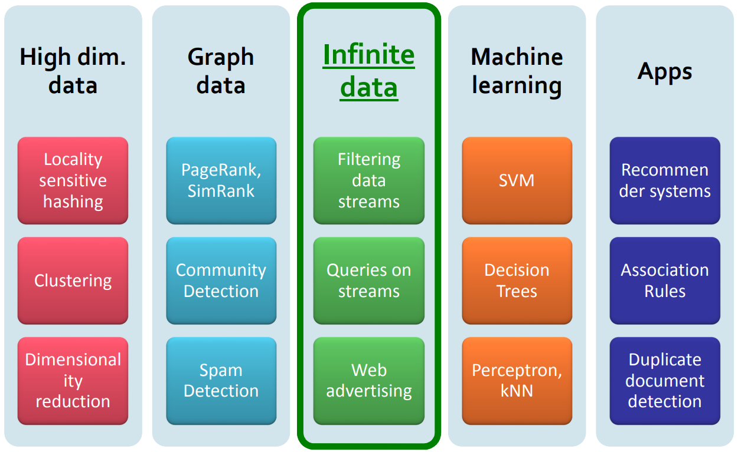

Slide 5
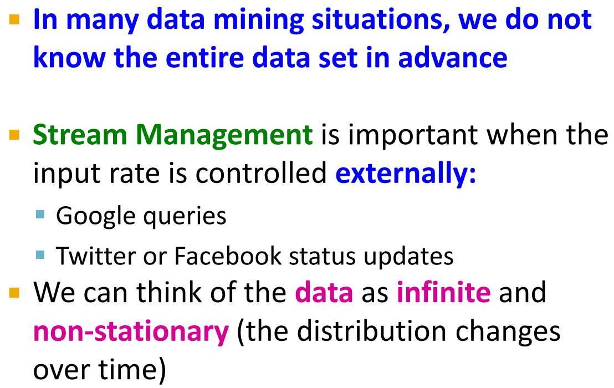
Data Streams

Slide 6
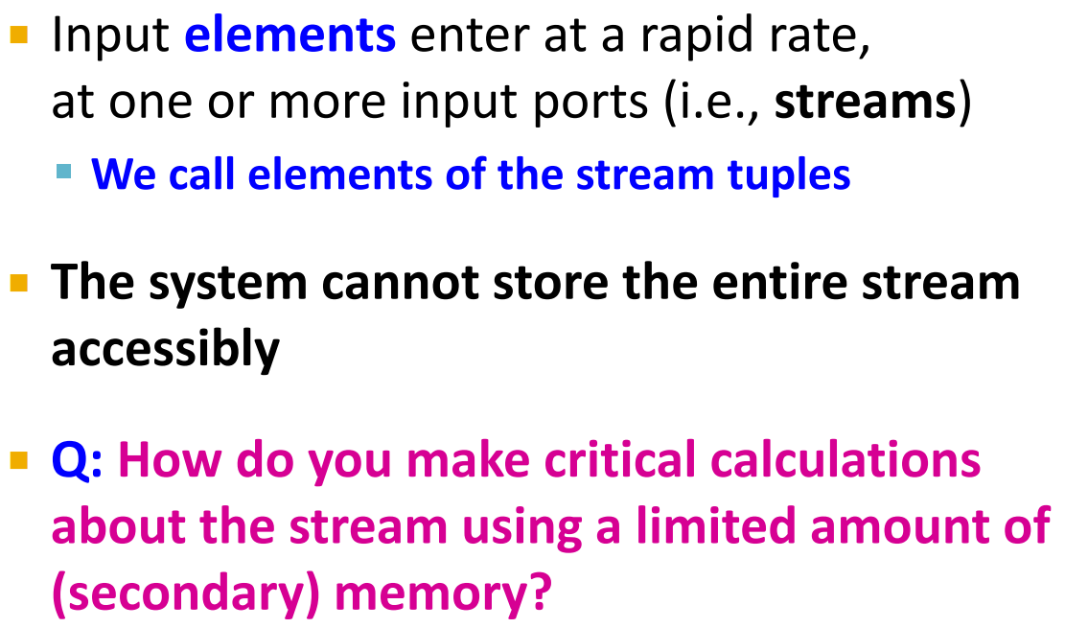
Stream Model

Slide 7
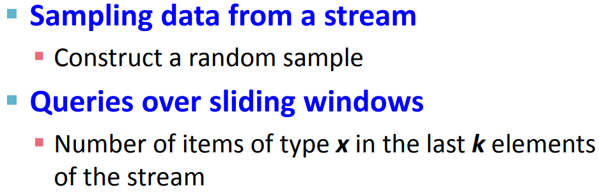
Problems of Data Stream

Slide 8
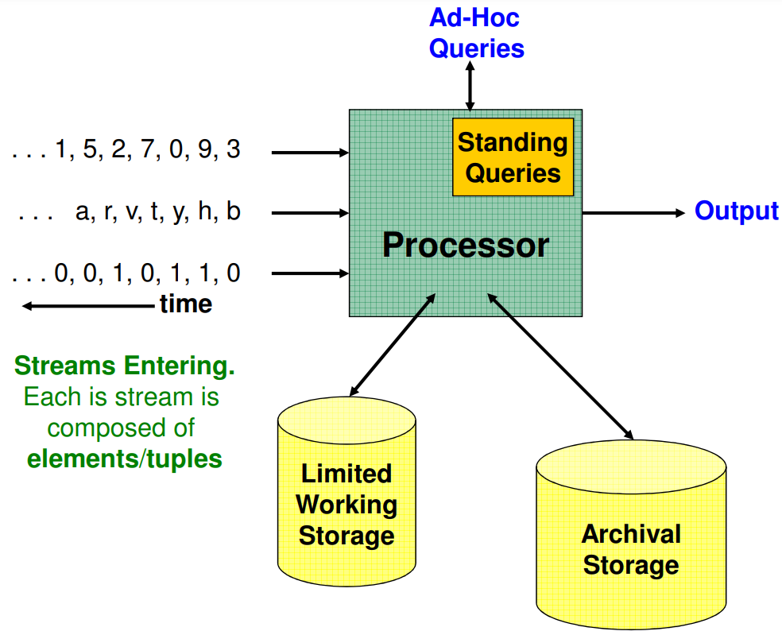

Slide 9
Stream Processor
Any number of streams can enter the system.
Each stream can provide elements at its own schedule; they need not have the same data rates or data types, and the time between elements of one stream need not be uniform.
The fact that the rate of arrival of stream elements is not under the control of the system distinguishes stream processing from the processing of data that goes on within a database-management system.

Slide 10
Limited storage vs. archival storage
Streams may be archived in a large archival store, but it is not possible to answer queries from the archival store.
It requires time-consuming retrieval processes.
There is also a working store, into which summaries or parts of streams may be placed, and which can be used for answering queries.
The working store might be disk, or it might be main memory, depending on how fast we need to process queries.
But either way, it is of sufficiently limited capacity that it cannot store all the data from all the streams.

Slide 11
standing queries
Standing queries are placed within the processor. These queries are permanently executing, and produce outputs at appropriate times.
Example are
The stream produced by the ocean-surface-temperature sensor might have a standing query to output an alert whenever the temperature exceeds 25 degrees centigrade.
The maximum temperature ever recorded by that sensor

Slide 12
Ad-hoc queries
A question asked once about the current state of a stream or streams.
If we do not store all streams in their entirety, as normally we can not, then we cannot expect to answer arbitrary queries about streams.
A common approach is to store a sliding window. sliding window can be the most recent n elements of a stream, for some n ,or it can be all the elements that arrived within the last t time units
The stream -management system must keep the window fresh, deleting the oldest elements as new ones come in.

Slide 13
Issues in Stream Processing
Streams often deliver elements very rapidly.
We must process elements in real time, or we lose the opportunity to process them at all.
Requires very large main memory
Requires the invention of new techniques in order to execute them at a realistic rate on a machine of realistic size.
Generalizations about stream algorithms worth bearing in mind, it is much more efficient to get an approximate answer to our problem than an exact solution.

Slide 14
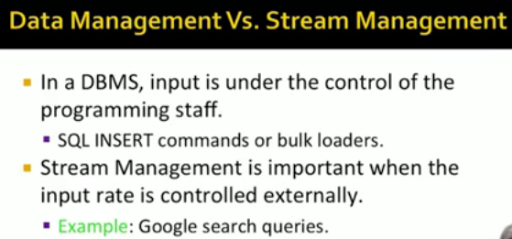

Slide 15
Sampling Data in a Stream
Selecting a subset of a stream so that we can ask queries about the selected subset and have the answers be statistically representative of the stream as a whole.
Search engine receives a stream of queries, and it would like to study the behavior of typical users. Let us assume the stream consists of tuples (user,query, time). We wish to store only 1/10th of the stream elements.
We use the hash function as a random-number generator,with the important property that, when applied to the same user several times, we always get the same “random” number.

Slide 16
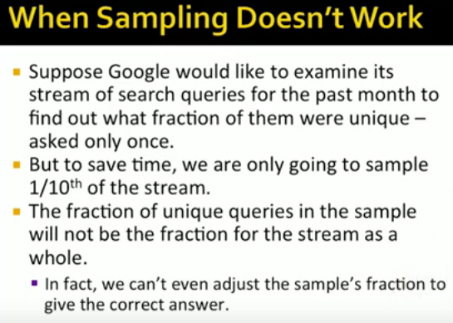

Slide 17
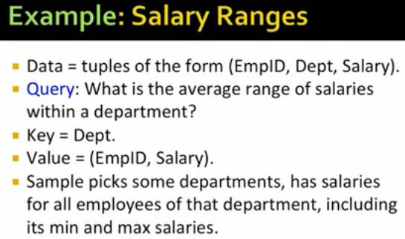
We want to work with let us say 10% of those tuples. Picking randomly any tuple will not work. For a given department we are likely to miss both of the employees with the minimum or maximum salary in that department. So we are biased because of poor sampling strategy. The right way to sample is to treat only the department component of the tuple as a key and employee ID, salary as a value.

Slide 18
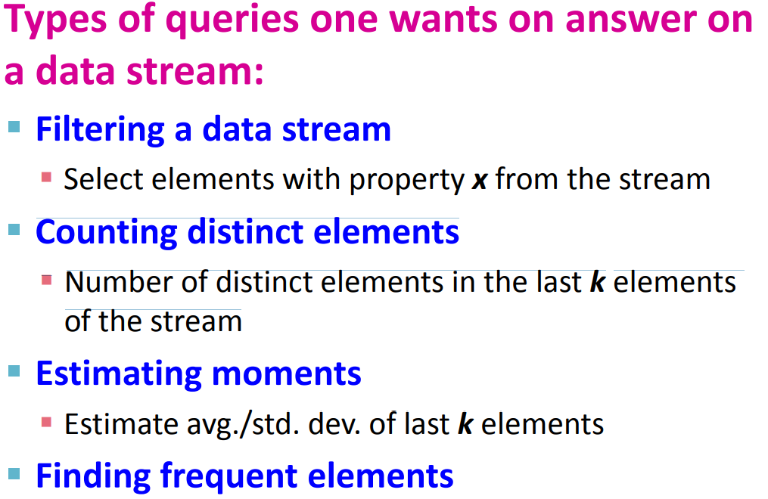

Slide 19
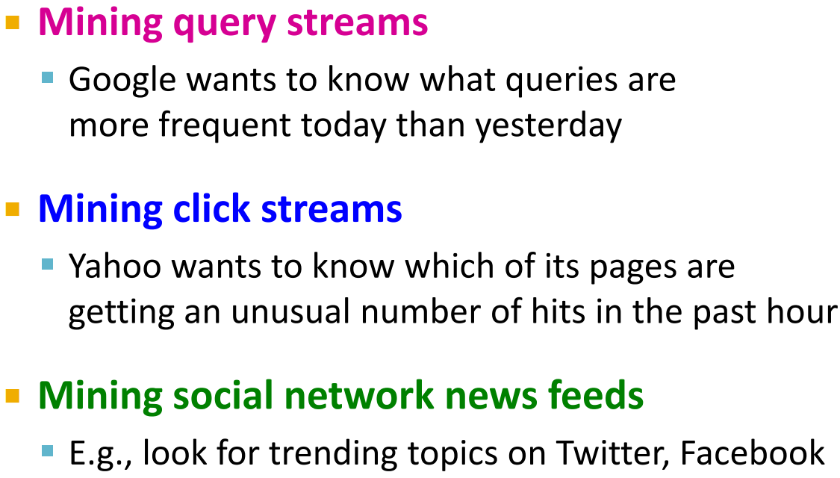

Slide 20
Flajolet Martin Algorithm
To count distinct elements in a stream

Slide 21
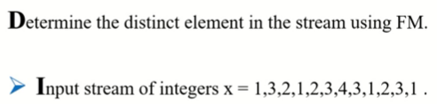

Slide 22
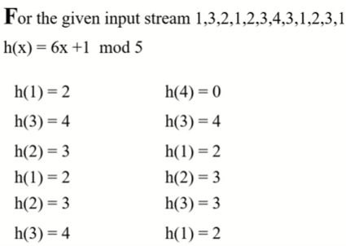

Slide 23
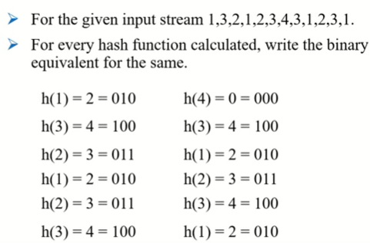

Slide 24
